Slide 1
Visual Inspection Workshop Emerson & Microsoft
Marianela Ramsdell
IoT
Cloud Solution Architect
Microsoft
Goutham Koneru
Data & AI
Cloud Solution Architect
Microsoft
Indy Boteju
IoT
Solution Specialist
Microsoft
Kay Apperson
Account Technology Strategist
Microsoft

Slide 2
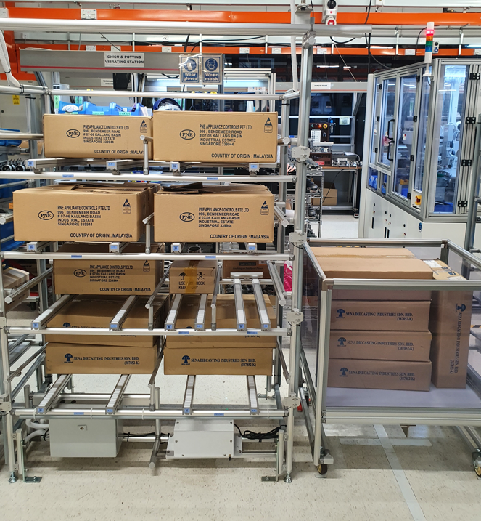



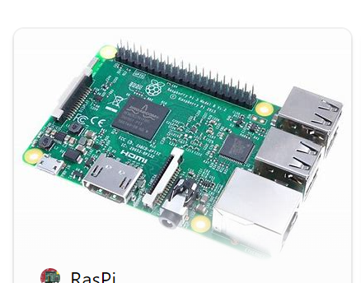

Visual Inspection Workshop – High Level
NO
Needs Replenishment?
Delete File, no action needed
YES
Trigger alert to warehouse

Slide 3

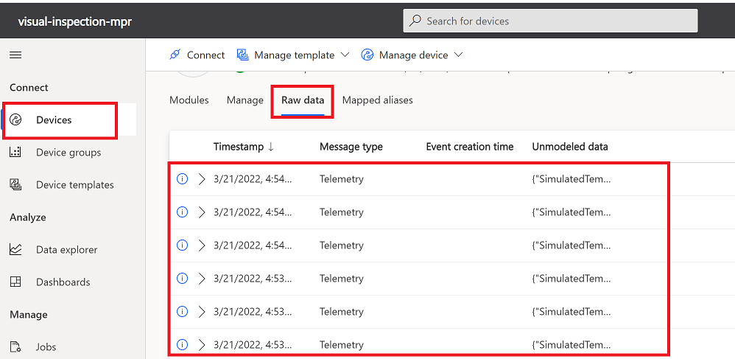
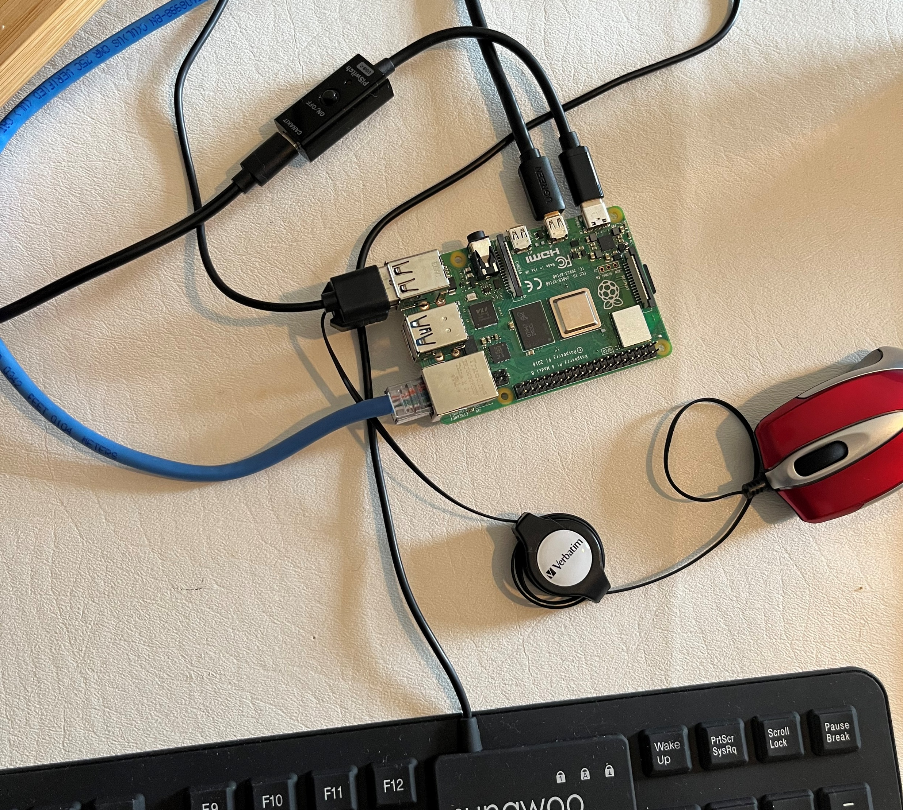

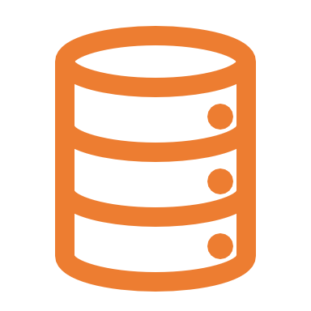
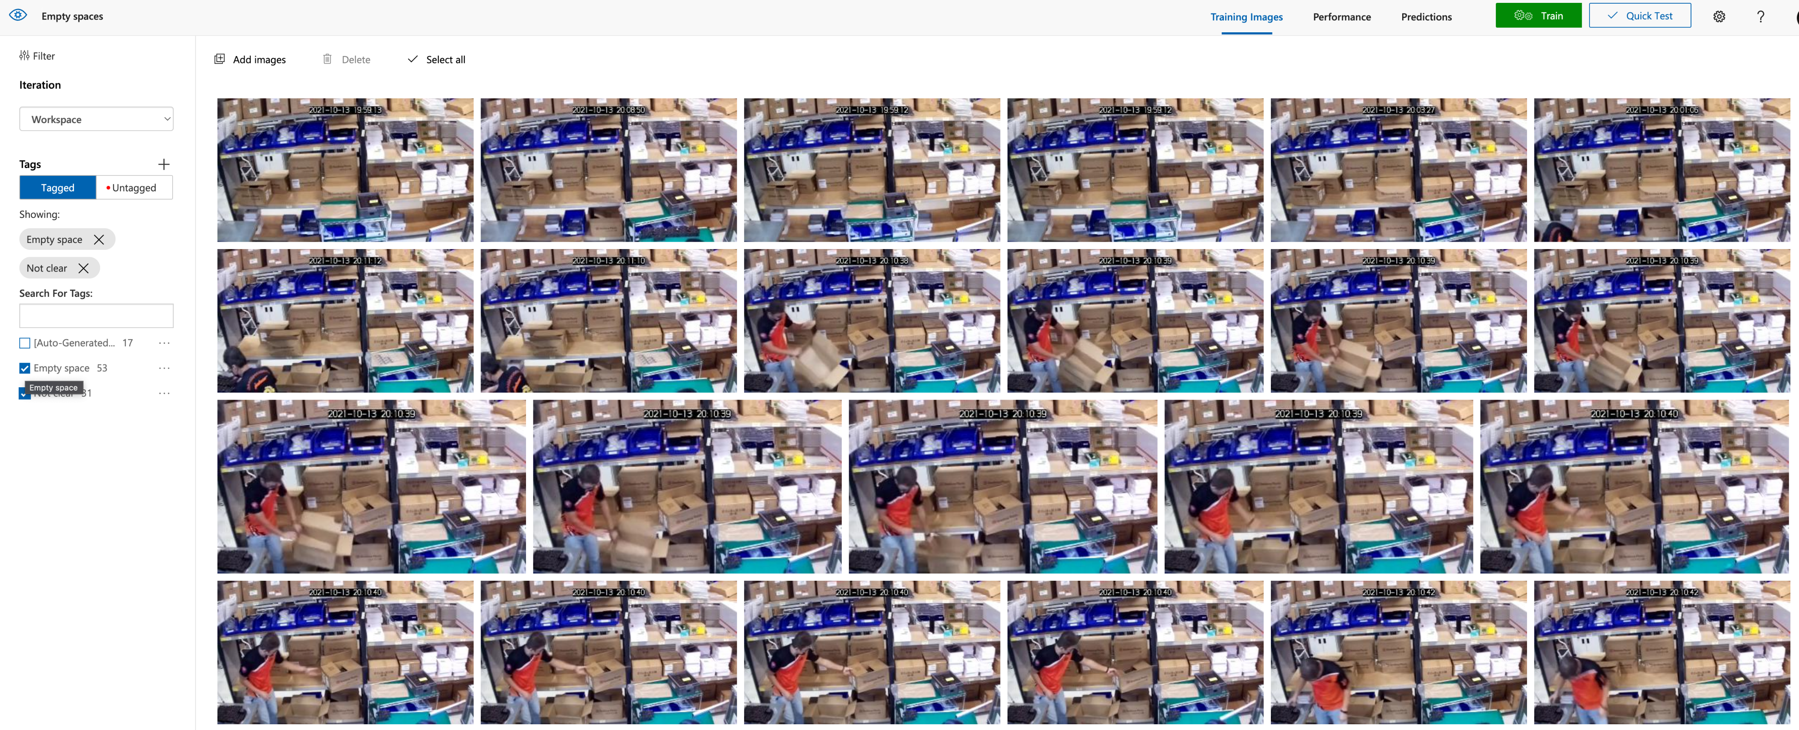
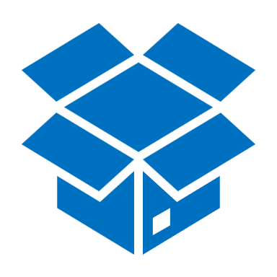
Visual Inspection Workshop - Technologies
Azure
Factory Floor
IoT Central Application
Edge Device
Telemetry data
Device management
Modules updates
Security updates
Pictures
Alerts
(Power Apps)
ML Model
Dashboards
(Power BI)
Camera
ML Model
Custom Vision Portal
Ubuntu OS
Edge runtime
ML Model
Data storage
(Many options)
Upload pictures
Tag the pictures
Generate the model
Export the model.
Azure Container Registry

Slide 4
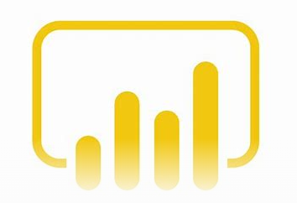



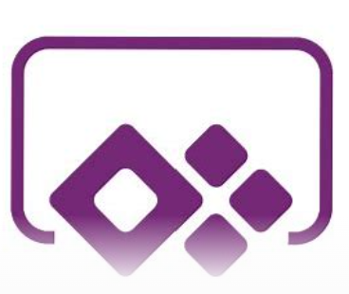
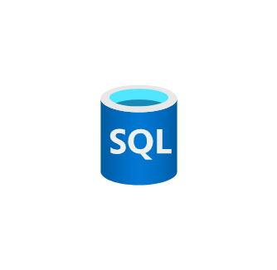
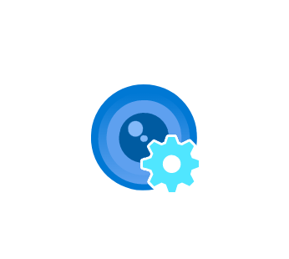

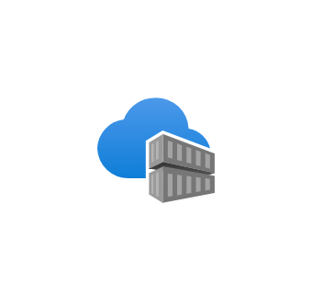
Architecture Diagram
PBI
IoT Central
Power Apps
Camera
Edge Device
SQL DB
Custom Vision
Storage Account
Container Registry

Slide 5
Workshop Sessions:
Session #1
Scope, business scenario
Device Set up
IoT Central Configuration
Enable connectivity from device to IoT Central, see sample telemetry data
Understanding technologies
Session #3
Deployment model to device
Connecting model in real time with camera
Analyze telemetry output
Set up basic alerts, store alerts
Session #2
Pre work: Collect pictures
Custom vision project set up
Upload Pictures, tag images, generate model
Analyzing output metrics.
Understanding technologies
Session #4
Troubleshoot
Analyze next steps
Additional time just in case we need it.
Overall Feedback

Slide 6



Why is IoT so Challenging?
Things
Cloud
Transformation

Slide 7


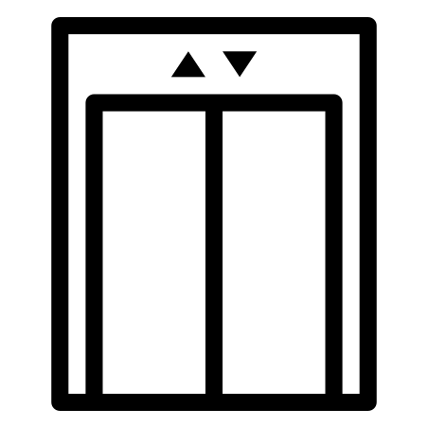


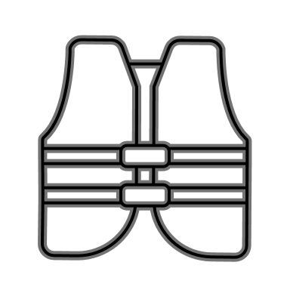
Complexity Emerges Quickly
Using IoT Data
Agriculture
Appliances
Consumer
Security
Buildings
Energy
Industrial
Lighting
Safety
Things
Cloud
Transformation

Slide 8

Complexity Emerges Quickly
Using IoT Data
Agriculture
How do I ensure this scales?
What about HA/DR?
How do I model my IoT data?
Where do I manage devices?
How can I manage user access?
What about hot, warm, and cold storage?
How do I know if my fleet is connected?
How can I get support for multi-tenancy?
How can I run commands against my devices?
What about APIs to access my data from other apps?
How can I transform data on ingress and egress?
….
Appliances
Consumer
Security
Buildings
Energy
Industrial
Lighting
Safety
Things
Cloud
Transformation

Slide 9









Removing Complexity
Ingestion & provisioning
Hot Path
Management
Web Experience
Using IoT Data
SaaS Environment
Agriculture
IoT Hub
Azure Stream Analytics
Appliances
IoT Hub
Manage your devices
View and analyze device data
Secure data and devices
Consumer
Warm Path
Raw Data View
Dashboards
User Mgmt
Security
DPS
Connectivity Status
Analytics
Organizations
DPS
Device Modeling
Rules
Buildings
Azure Data Explorer
Jobs
Azure Data Explorer
Energy
Cold Path
Industrial
Lighting
Built on a managed multi-tenant PaaS services layer that delivers
SQL DB
Safety
High Availability
Elastic Scale
Disaster Recovery
Cosmos DB
Things
Cloud
Transformation

Slide 10

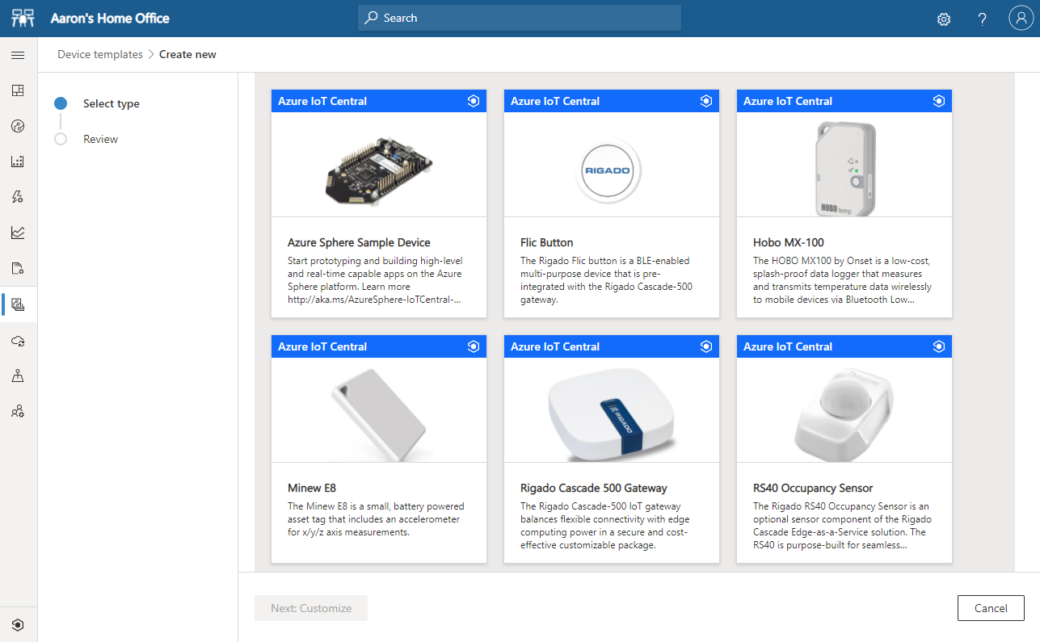
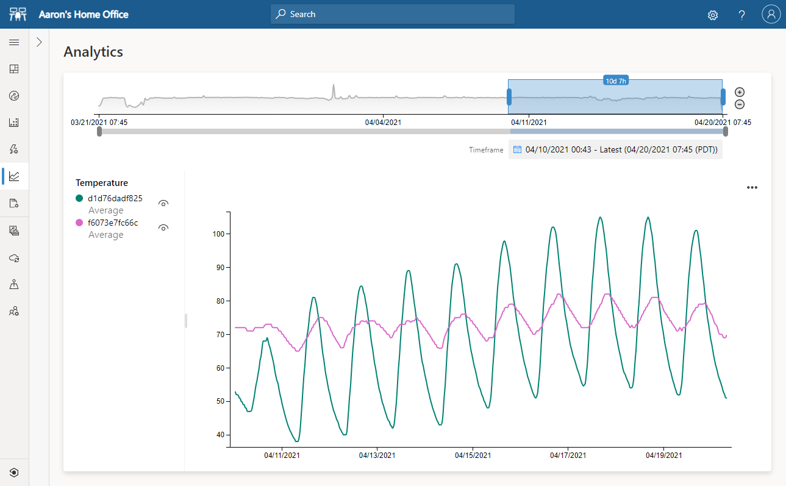
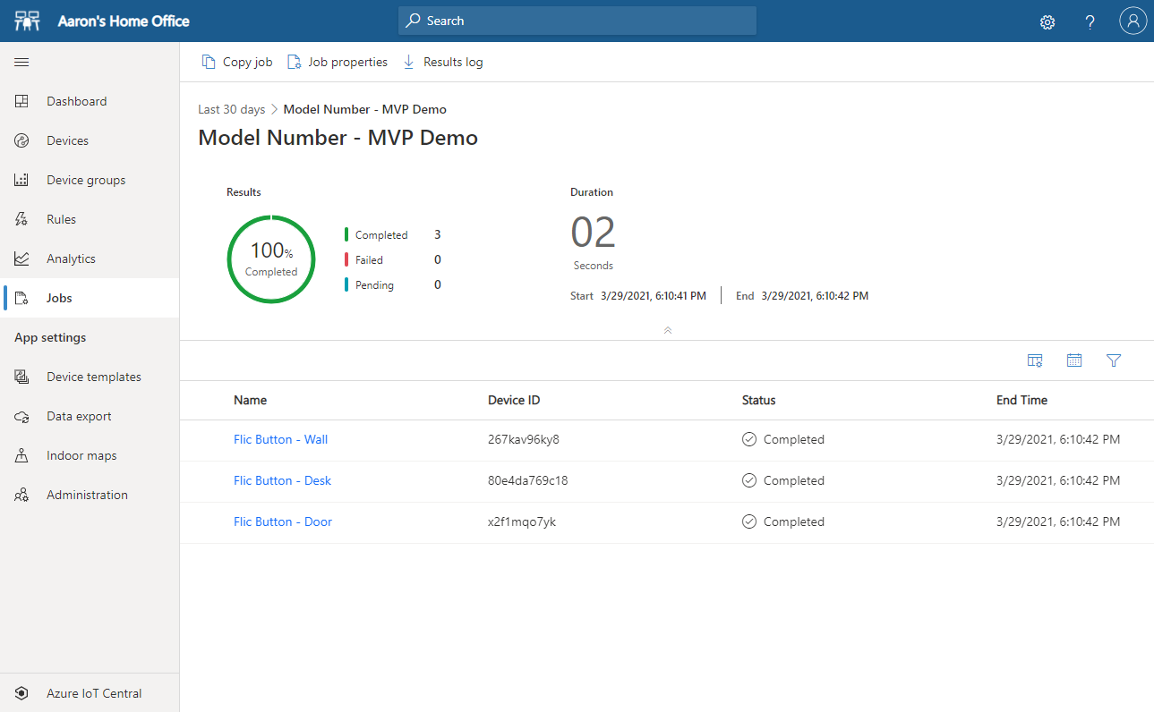
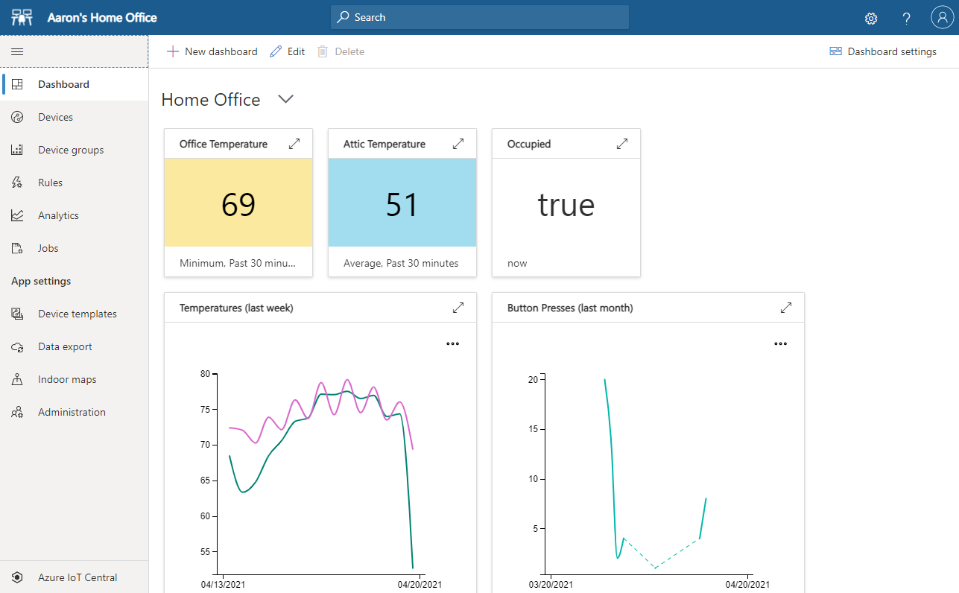
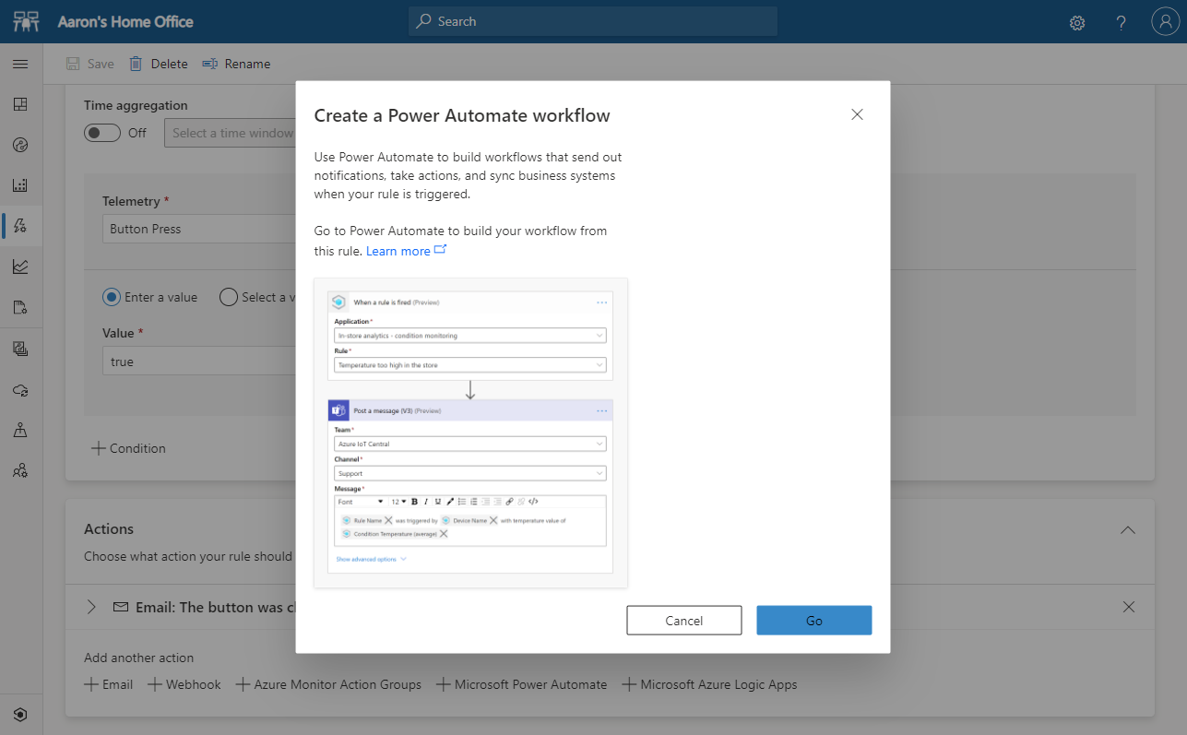
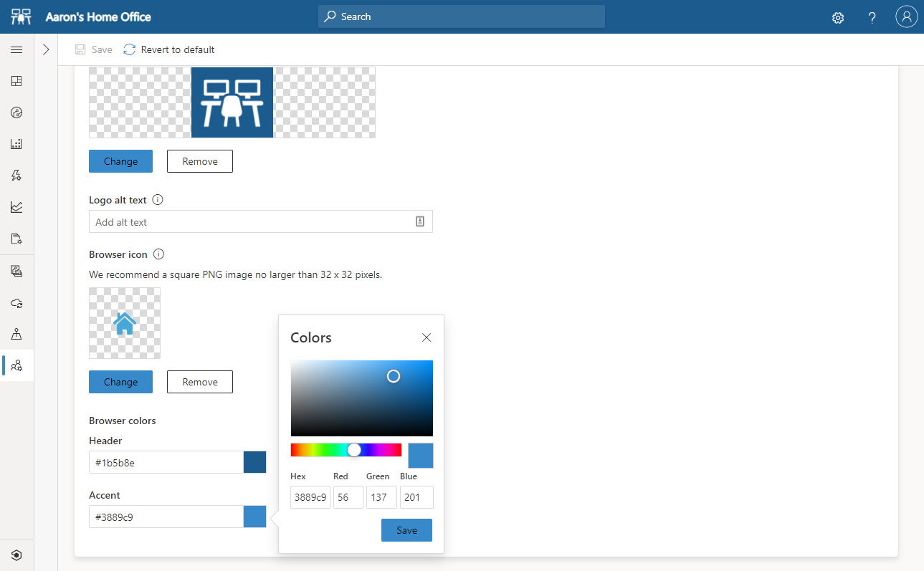
Removing Complexity
Azure IoT Central
Using IoT Data
Agriculture
Connect devices
View and structure IoT Data
Cloud to device interactions
Appliances
Consumer
Security
Buildings
Monitor device health
Integrate with business apps
Customize
Energy
Industrial
Lighting
Safety
A ready-made environment for IoT solution development
Scalable, Repeatable, Reliable
Things
Transformation
Notes:
We often describe IoT Central as going from “proof of concept”… to “proof of value”.

Slide 11



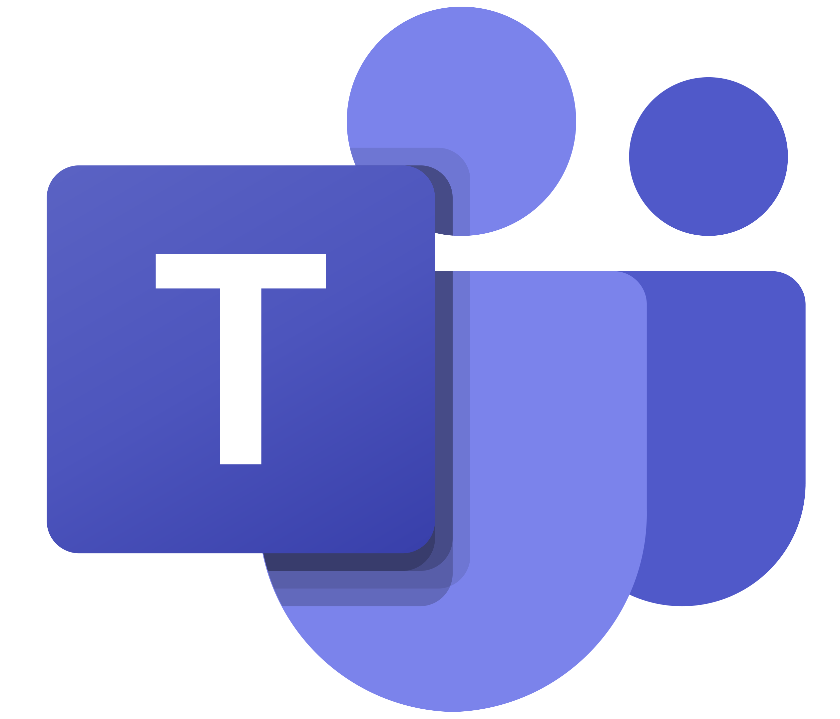


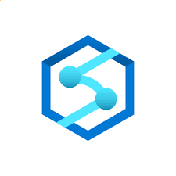
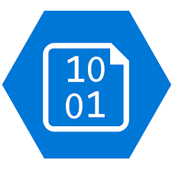



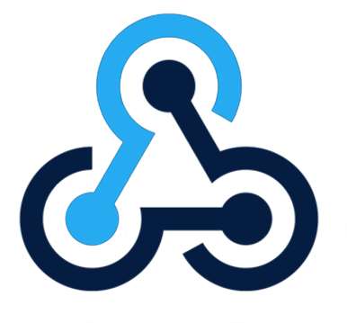





Shifting the Focus to New Differentiated Value
Azure IoT Central
Agriculture
Connect devices
View and structure IoT Data
Cloud to device interactions
for experiences and insights
Appliances
Consumer
for storage or analysis
Security
Buildings
Monitor device health
Integrate with business apps
Customize
for business automation
Energy
Industrial
Lighting
for further computations
Safety
A ready-made environment for IoT solution development
Scalable, Repeatable, Reliable
Things
Transformation

Slide 12
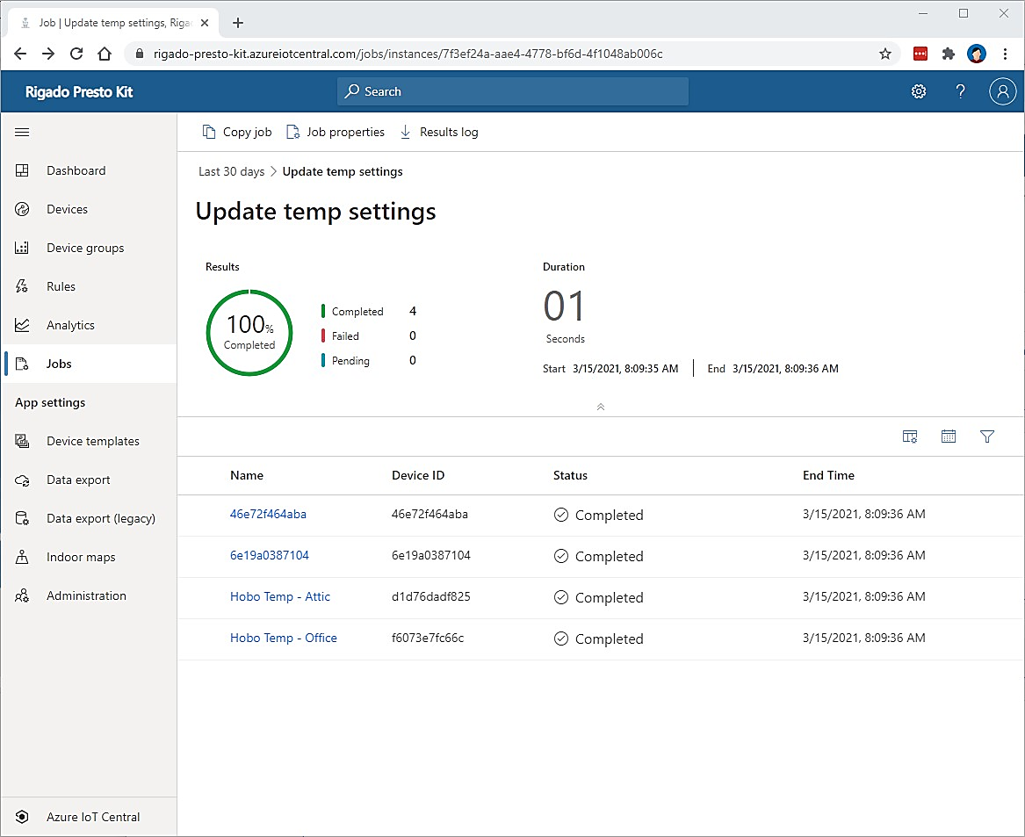
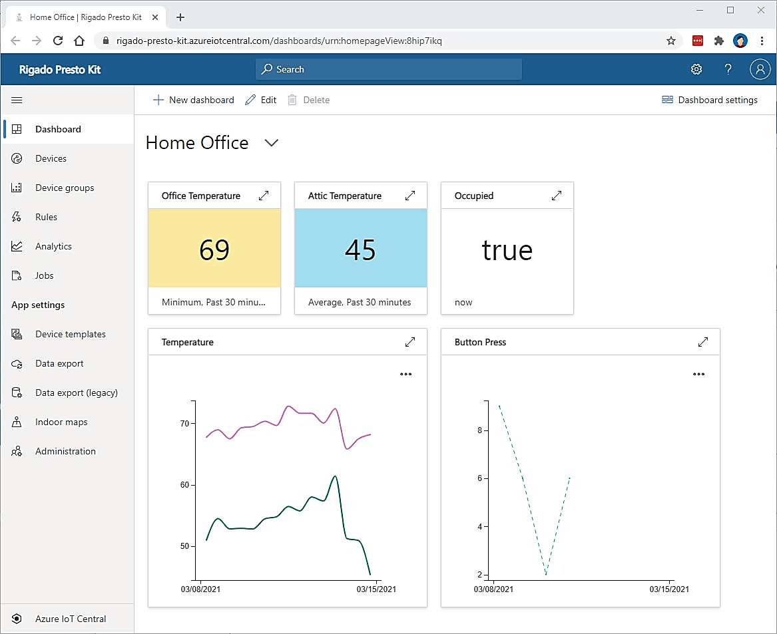
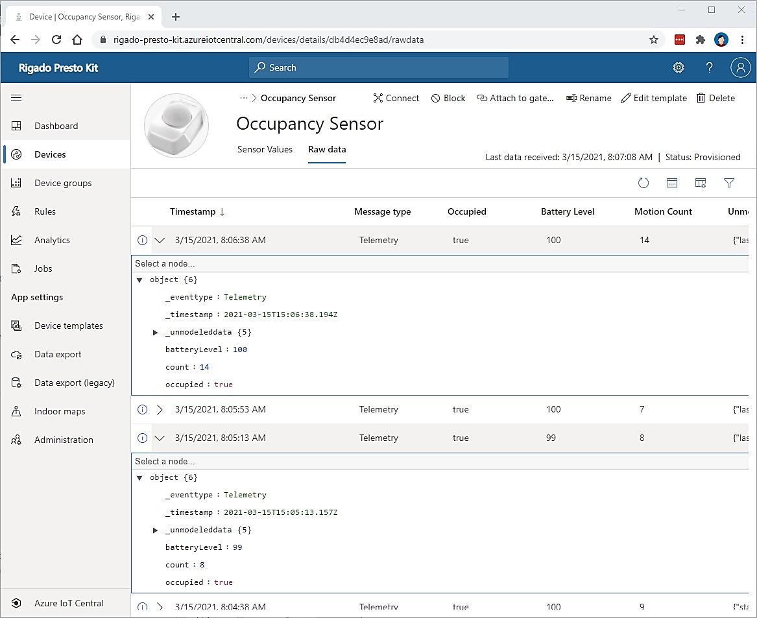
What is a “ready-made environment”?
Azure IoT Central
A ready-made environment for IoT solution development
High Availability, Disaster Recovery, Elastic Scale, Solution Security
aPaaS
Notes:
So, let’s talk a bit more about what this “ready made environment” is… more and more the industry refers to platforms like IoT Central as aPaaS.

Slide 13
Appendix

Slide 14
Typical Manufacturing Systems…
ERP
Plant (prod. lifecycle, scheduling)
MES
SCADA
Line (Monitoring)
OPC
HMI
Machine/Tool/Equipment (sensors and actuators)
PLC
SHOP FLOOR

Slide 15
...Requires transformation to unlock the value of data
Enterprise & Plant Topology
Information Systems
ERP-Level
Enterprise Resources
Responsive and dynamic cross-Industry Value Networks
Finance, HR, SCM, SRM, CRM …
Plant Schedules, Products, BOMs, Routings, Quality, Performance …
MES-Level
Manufacturing Execution Systems
Cross-plant performance, coordination & flexibility
HMI, SCADA, Alarms, Events, Historians …
Control-Level
Machine Controllers
Production optimization & reduced process costs
Device-Level
Sensors, Devices
Intelligent equipment with reduced failures & downtime
Automation Control, Safety, …

Slide 16
First step… get connected through a common communication model
SETTINGS
Something has happened on the machine. For example:
Machine Started production
Machine Ended production
A setting has been changed on the machine
A raw material has been replaced
Event Data
Controller (PLC)
OPC
Field
GTW
Process
Process variables read and sent at specific time interval. For example:
Component part rejection rate
Chamber air pressure
Solder temperature
Telemetry Data
Process Variables

Slide 17
Second step… develop dashboards to allow global visibility…
TALLAHASSEE
MUNICH
NEW DELHI
ALERT
ONLINE
ONLINE
Global Control Room
Aggregate data from machines across your manufacturing sites to enable a holistic view of key performance indicators
Drill into your data to compare the performance of equivalent machines at multiple sites
Gain insight into the factors that contribute to variations in performance

Slide 18
Business Value Optimize the Manufacturing Plant
Monitor production flow in near-real time to eliminate waste and unnecessary work in process inventory.
Manage equipment remotely, using temperature limits and other settings to conserve energy and reduce costs.
Analyze plant data to act quickly on production insights like inefficiencies or bottlenecks and enhance productivity.
Provide cross-channel visibility into inventories to optimize supply and reduce shared costs in the value chain.
Implement condition-based maintenance alerts to eliminate machine down-time and increase throughput.
Aggregate product data, customer sentiment, and other third-party syndicated data to identify and correct quality issues.
Third-party logistics
CUSTOMER

